Slide 1



MASS PO CLOSURE DASHBOARD
View in Power BI
Last data refresh:
7/25/2022 1:38:28 PM UTC
Downloaded at:
7/26/2022 10:42:03 AM UTC

Slide 2
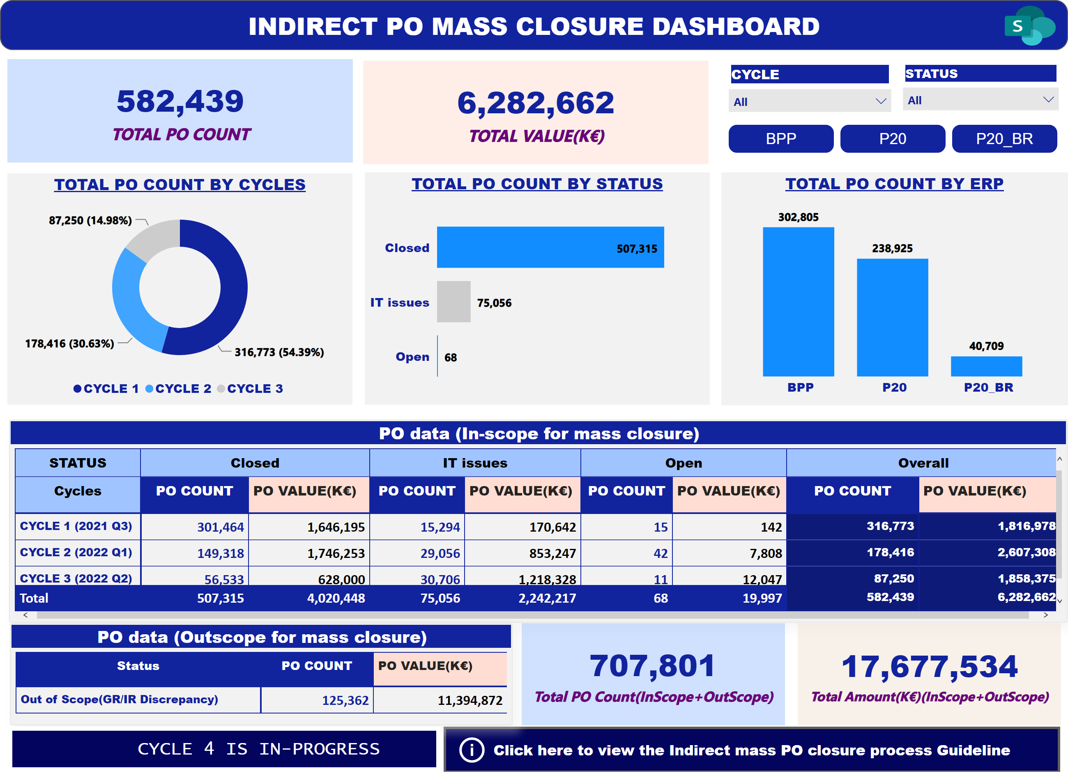
MASS PO CLOSURE DASHBOARD
Notes:
ScrollingTextVisual1448795304508
No alt text provided
actionButton
No alt text provided
PO data (Outscope for mass closure)
No alt text provided
actionButton
No alt text provided
card
No alt text provided
card
No alt text provided
PO data (In-scope for mass closure)
No alt text provided
image
No alt text provided
ChicletSlicer1448559807354
No alt text provided
card
No alt text provided
slicer
No alt text provided
slicer
No alt text provided
TOTAL PO COUNT BY ERP
No alt text provided
TOTAL PO COUNT BY STATUS
No alt text provided
TOTAL PO COUNT BY CYCLES
No alt text provided
actionButton
No alt text provided
card
No alt text provided

